Slide 1

MAT 2901 Statistical and mathematical modeling
Spring 2021

Slide 2
What is Statistical/Mathematical Modeling?
Statistical modeling is the use of mathematical models and statistical assumptions to generate sample data and make predictions about the real world.
It refers to the process of applying statistical analysis to datasets.
A statistical model is a collection of probability distributions on a set of all possible outcomes of an experiment.
Its application to raw data helps scientists approach data analysis in a strategic manner, providing intuitive visualizations that aid in identifying relationships between variables and making predictions.

Slide 3
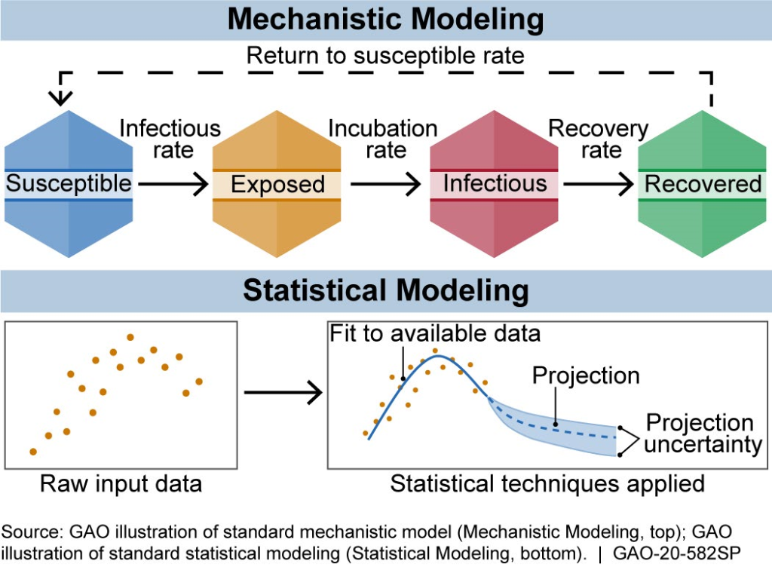
An example of such a model is the SEIR model depicted here.
Raw data may be represented as counts of infectious, exposed, and recovered individuals over time.
With the appropriate model, we might ‘fit’ it to our data and use it to draw predictions or probabilistic statements.
https://blog.gao.gov/2020/06/09/disease-modeling-how-math-can-help-in-a-pandemic/

Slide 4
What is Statistical/Mathematical Modeling?
The first step in developing a statistical model is gather data (data science process).
The most common statistical modeling methods for analyzing this data are categorized as either supervised learning or unsupervised learning.
Supervised Learning:
Regression model: a type of predictive statistical modeling analyzing the relationship between dependent and independent variables. (e.g. linear, polynomial, logistic regression)
Classification model: a type of machine learning in which an algorithm tries to classify outcomes based on data. (e.g. Decision trees, random forests)
Unsupervised Learning:
Techniques include clustering algorithms and association rules; take Holly’s DS 2 class.
In this class, we’ll focus primarily on supervised learning techniques and mathematical models.

Slide 5
Statistical Modeling vs. Mathematical Modeling
Much like statistical modeling, mathematical modeling translates real-world problems into tractable mathematical formulations whose analysis provides insight, results and direction useful for the originating application.
However, unlike statistical modeling, mathematical modeling involves static (deterministic) models that represent a real-world phenomenon in mathematical form.
Once a mathematical model is formulated, it does not necessitate change (variation). Statistical models are flexible and, with the aid of machine learning, can incorporate new, emerging patterns and trends, and will adjust with the introduction of new data.
Statistics’ core concept is that it is the science of variation. Our goal as scientists is to recognize variation in the numerous contexts we’re in and try to quantify this uncertainty. I like to think of modeling often as a process of uncertainty quantification.
“Essentially all models are wrong, but some are useful.” The quotation comes from George Box, one of the great statistical minds of the 20th century.

Slide 6
An Idea of What We’ll Do
Part I: R Programming and Exploratory Data Analysis
Learning to use R, basic statistics, visualizations, understanding statistical measurements and relationships, correlation and linear regression.
Part II: Probability and Sampling Distributions
Cover the fundamentals of probability and probability distributions, fundamental statistical models, random variables, Central Limit Theorem, simulation.
Part III: Statistical Testing and Modeling
One-sample inference (hypothesis testing and confidence intervals), small sample methods (nonparametric), errors and power of testing, fitting an epidemic model.
Part IV: Advanced Models and Assessment
Analysis of variance, post-hoc methods, multiple regression, choosing and evaluating models, tree-based methods,

Slide 7
References
https://www.omnisci.com/technical-glossary/statistical-modeling#:~:text=Statistical%20modeling%20is%20the%20use,possible%20outcomes%20of%20an%20experiment.
https://blog.gao.gov/2020/06/09/disease-modeling-how-math-can-help-in-a-pandemic/

